Slide 1
INTRODUCTION TO SOFTWARE TESTING

Slide 2
CONTENTS
1. Testing Fundamentals
2. Software Testing Lifecycle
3. Testing Techniques
4. Test management and control
5. Defect management

Slide 3
1. Testing Fundamentals
Introduction to Software Testing
The seven principles of Testing
Psychology of Testing
The fundamental test process

Slide 4
1. Testing Fundamentals
Introduction to software testing
Consider the following scenarios:
China Airlines Airbus A300 crashed due to a software bug on April 26, 1994, killing 264 innocent lives
In 1985, Canada's Therac-25 radiation therapy machine malfunctioned due to software bug and delivered lethal radiation doses to patients, leaving 3 people dead and critically injuring 3 others
In April of 1999, a software bug caused the failure of a $1.2 billion military satellite launch, the costliest accident in history
In may of 1996, a software bug caused the bank accounts of 823 customers of a major U.S. bank to be credited with 920 million US dollars
Notes:
Give the car example diving into the slide content
One can tell from all the aforementioned scenarios that there was lack of adequate testing

Slide 5
1. Testing Fundamentals
So …..
What is Software testing?
Notes:
Pause for feedback

Slide 6
1. Testing Fundamentals
Software testing is a process used to identify the correctness, completeness, and quality of a software system.
It includes a set of activities conducted with the intent of finding errors in software so that it could be corrected before the product is released to the end users.

Slide 7
1. Testing Fundamentals
Seven Fundamental Principles of testing
Testing shows presence of defects
Exhaustive testing is impossible
Early testing
Defect Clustering
Pesticide Paradox
Testing is context-based
Absence of errors-fallacy

Slide 8
1. Testing Fundamentals
Psychology of testing
Who will test an application better?
Those who wrote the code?
Members of the same development team?
Members of a different group (independent test team)?
Members of a different company (a testing consultancy/outsourced)?

Slide 9
1. Testing Fundamentals
Fundamental test process
Test Planning and Control
Test Analysis and Design
Test Implementation and Execution
Evaluating exit Criteria and Reporting
Test Closure activities

Slide 10
2. Testing Lifecycle
Software Development Models
Testing levels
Testing types

Slide 11
2. Testing Lifecycle
Software development models
Waterfall
V-model (Sequential development model)
Iterative-incremental development models

Slide 12
2. Testing Lifecycle
Waterfall Model
User/Business Requirement Specification
System Requirement Specification
Design
Development/Coding
Testing

Slide 13
2. Testing Lifecycle
V-model
User/Business requirement Specification
Acceptance test
System Requirement Specification
System test
Design
Integration Test
Development/Coding
Unit test

Slide 14
2. Testing Lifecycle
Iterative-Incremental development model
Requirement
Design
Code
test

Slide 15
2. Testing Lifecycle
Testing levels
Unit Test
Integration Test
System Test
Acceptance Test

Slide 16
2. Testing Lifecycle
Testing Types
Functional Testing
Non-Functional Testing
Structural Testing
Maintenance Testing

Slide 17
3. Testing techniques
Review
Formal
Informal
Static Analysis by tool
Data Flow
Control Flow
STATIC TESTING
DYNAMIC TESTING
Specification based Testing
Equivalence Partitioning
Boundary Value Analysis
Experience based Testing
Error Guessing
Exploratory testing
Structure based Testing
Statement Coverage
Branch Coverage
Decision Table
State Transition
Use case testing
Condition Coverage
Path Coverage
Functional Coverage

Slide 18
3. TESTING TECHNIQUES
Specification based/Black box techniques
Equivalence Partitioning and Boundary Value Analysis Example:
If a balance in the range N0 up to N10000 has a 3% interest rate, a balance over N10000 and up to N100000 has a 5% interest rate, and balances of over N100000 has a 7% interest rate,
Invalid | Valid for 3% | Valid for 5% | Valid for 7%
-0.01 | 0 10000 | 10000.01 100000 | 100000.01

Slide 19
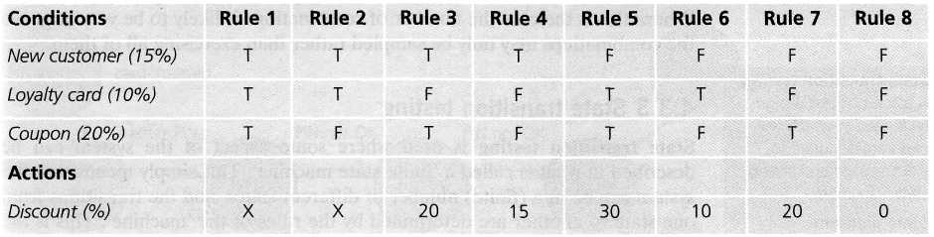
3. TESTING TECHNIQUE
Decision table

Slide 20
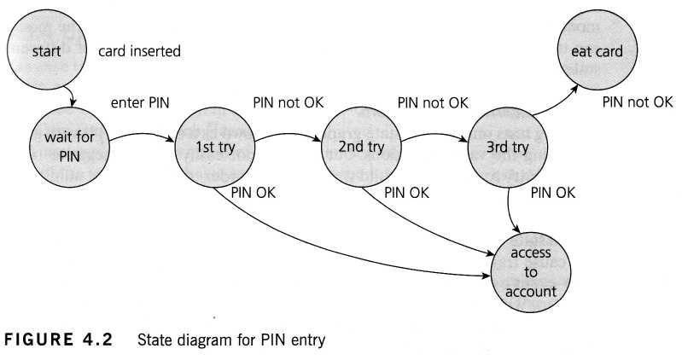
3. TESTING TECHNIQUE
State Transition Diagram

Slide 21
4. Test management and control
Test Planning and estimation
Testing tools

Slide 22
4.Test management and control
Test Planning and estimation
Test Plan
1. Analyze the product
2. Design Test Strategy
3. Define Test Objectives
4. Define Test Criteria
5. Resource Planning
6. Plan Test Environment
7. Schedule & Estimation
8. Determine Test Deliverables

Slide 23
4. Test management and control
Test Estimation: Resources, Time, Human Skill and cost
Three Point Estimation
Functional Point Estimation
Work Breakdown Structure

Slide 24
4. Test management and control
Test management tool
Requirement management tool
Configuration management tool
Test execution tool
Incident management tool
Testing tools

Slide 25
5. Defect management
A defect occurs when the actual result varies from the expected result
Defect/Incident management (according to IEEE) is the process of recognizing, investigating, taking action and disposing of incidents.
It involves recording incidents, classifying them and identifying the impact.

Slide 26
5. DEFECT MANAGEMENT
Discovery
Categorization
Verification
Closure
Reporting
Resolution

Slide 27
5. DEFECT MANAGEMENT
Major Contents of a defect report
Defect ID
Defect Description
Version
Steps to reproduce the defect
Severity
Priority
Reference
Status

